Slide 1
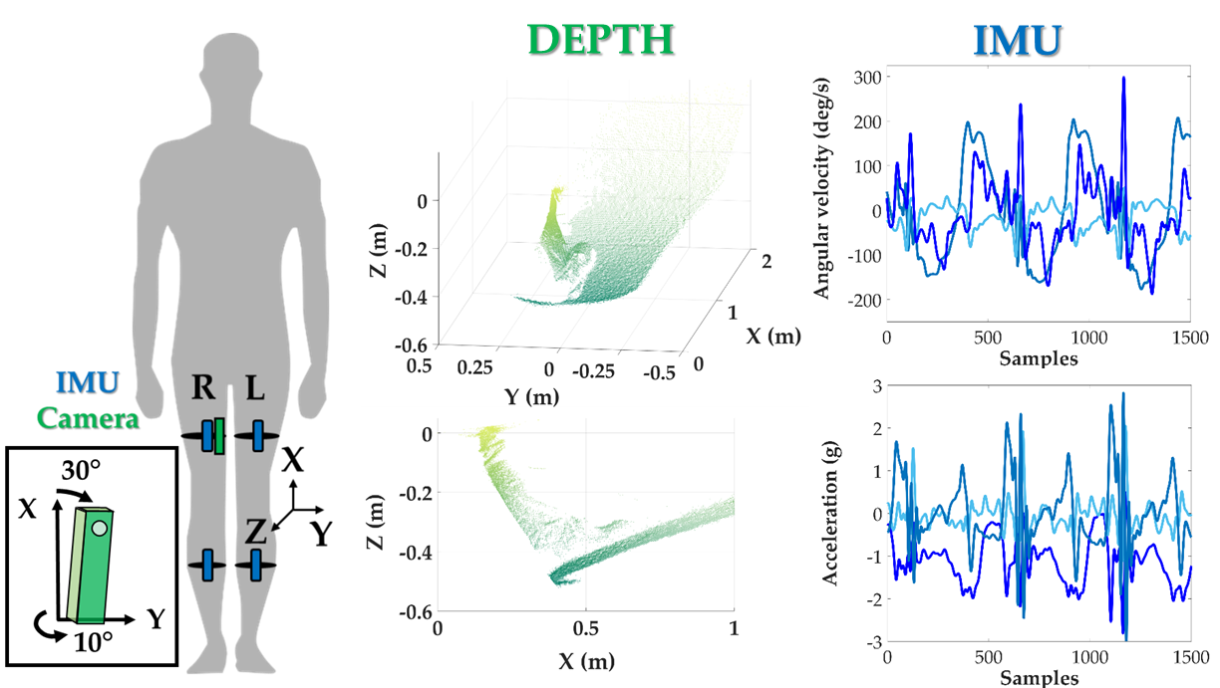

Slide 2
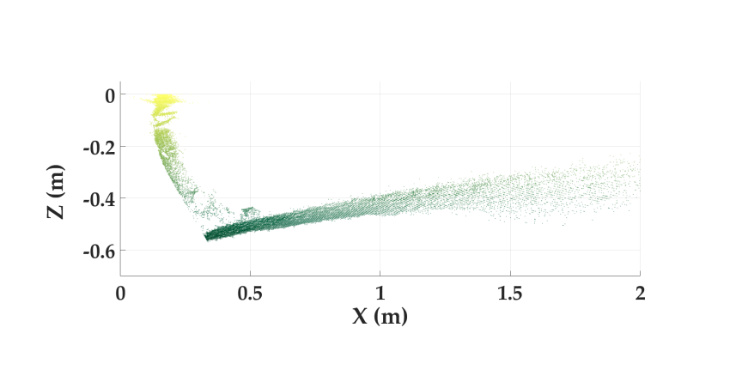
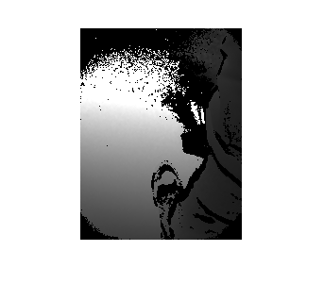
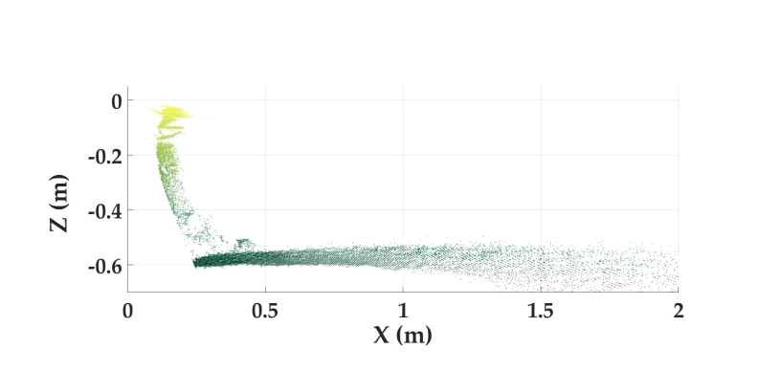
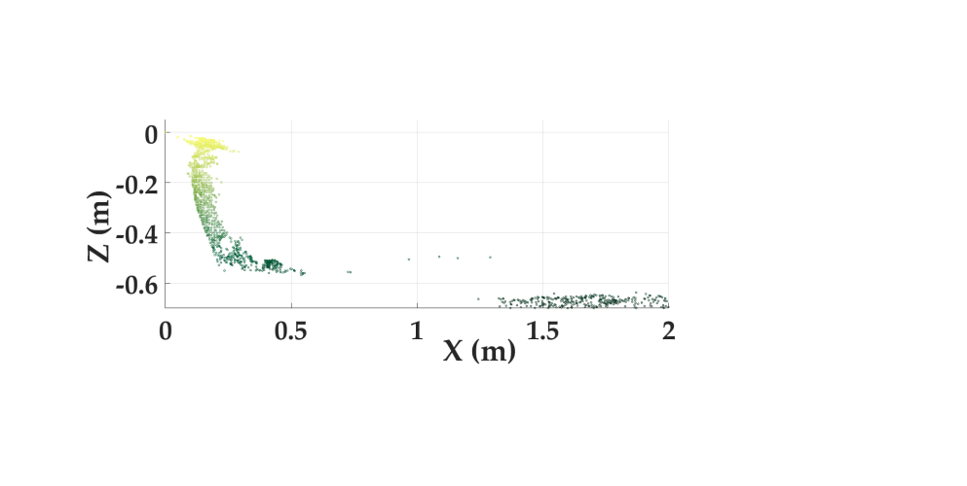
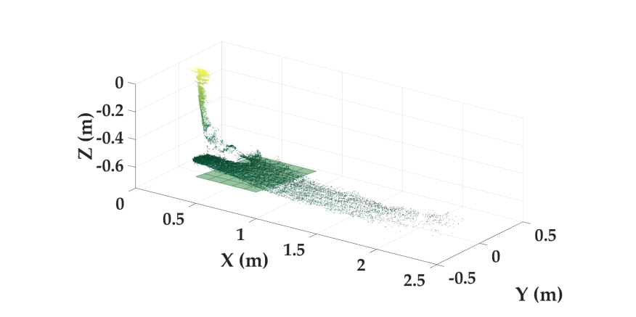

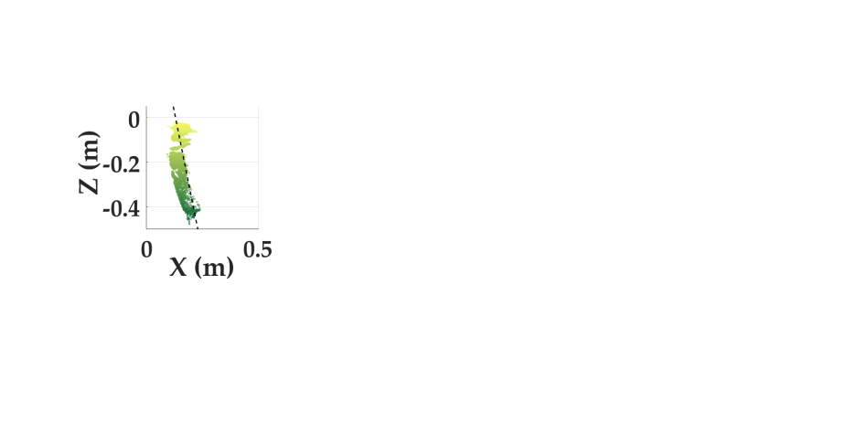
Raw Data
Depth data
2D Projection
Left (Contralateral) Foot and Shank
a) Right Leg
b) Left Leg
1a) Remove Initial Rotation
1b) 2D Ground Removal
2a) RANSAC Ground Fit
Ground Angle, θ
Shank Angle, φ
2b) Morphological Filtering & CCL
3b) Shank Linear Fit

Slide 3
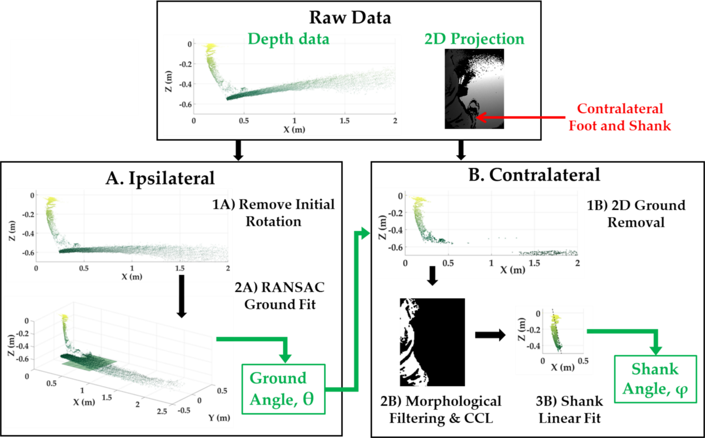

Slide 4
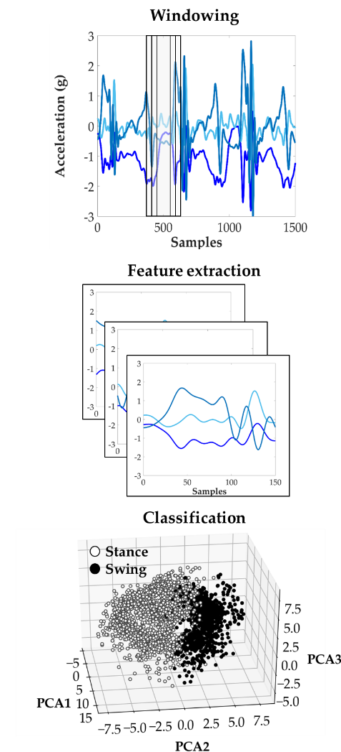

Slide 5
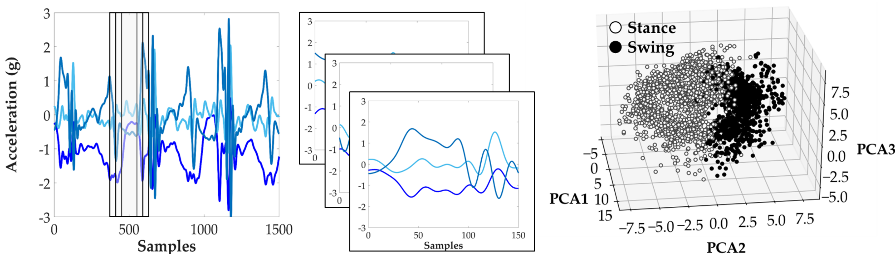
Windowing
Feature extraction
Classification

Slide 6
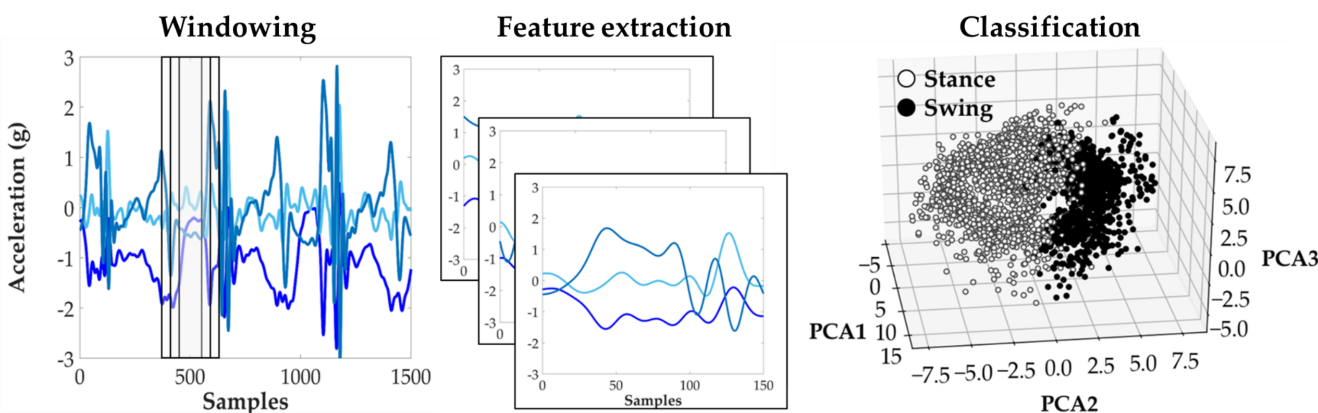

Slide 7
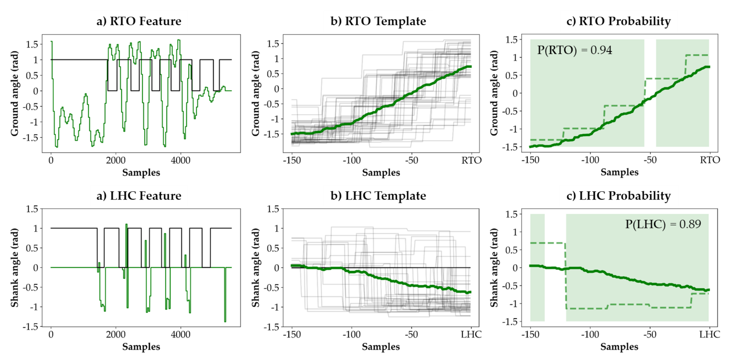

Slide 8
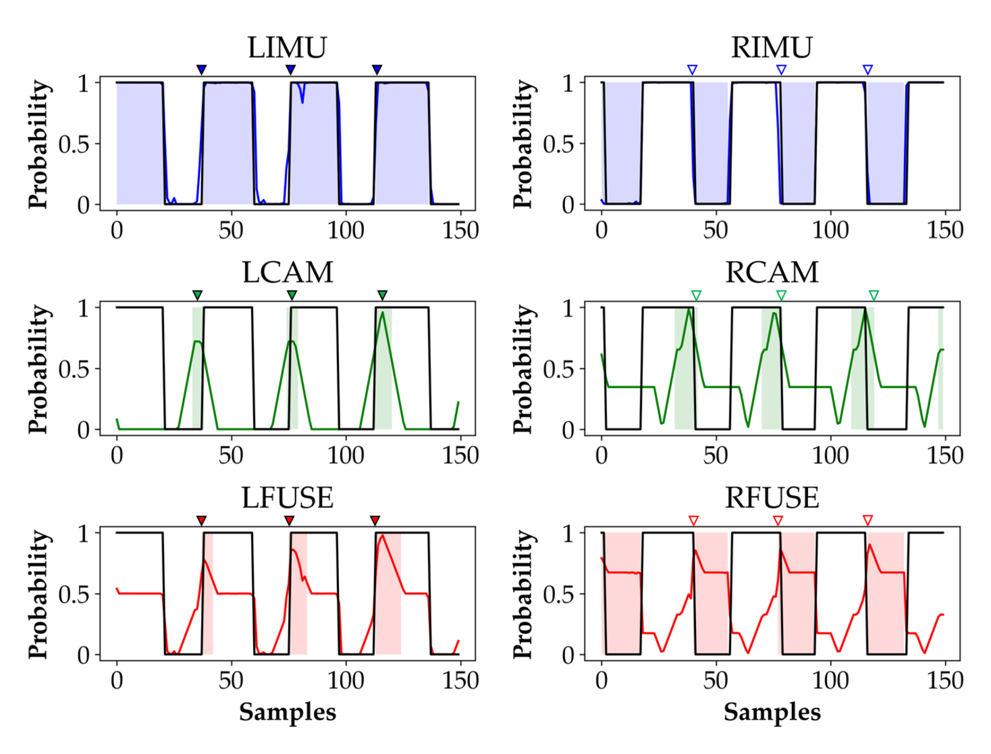
a) LHC
IMU
b) RTO
IMU
DEPTH
DEPTH
FUSED
FUSED

Slide 9
LHC (n = 57) | Mean (ms) | SD (ms) | Outliers
R Thigh | -23 | 69 | 0
R Thigh + Shank | -8 | 56 | 0
R/L Thigh + Shank | -4 | 30 | 0
CAM | 3 | 106 | 10
FUSED | -13 | 61 | 3
RTO (n = 54) | Mean (ms) | SD (ms) | Outliers
R Thigh | -6 | 41 | 0
R Thigh + Shank | 1 | 42 | 0
R/L Thigh + Shank | -9 | 42 | 0
CAM | -7 | 85 | 0
FUSED | -5 | 39 | 0
LDA

Slide 10
LHC (n = 57) | Mean (ms) | SD (ms) | Outliers
R Thigh | -23 | 69 | 0
R Thigh + Shank | -8 | 56 | 0
R/L Thigh + Shank | -4 | 30 | 0
CAM | -34 | 107 | 7
FUSED | -15 | 63 | 6
RTO (n = 54) | Mean (ms) | SD (ms) | Outliers
R Thigh | -6 | 41 | 0
R Thigh + Shank | 1 | 42 | 0
R/L Thigh + Shank | -9 | 42 | 0
CAM | -7 | 85 | 0
FUSED | -5 | 39 | 0
LDA
Redo
Using
Non-binarized
LHC feature

Slide 11
LHC (n = 57) | Mean (ms) | SD (ms) | Outliers
R Thigh | -23 | 69 | 0
R Thigh + Shank | -8 | 56 | 0
R/L Thigh + Shank | -4 | 30 | 0
CAM | -34 | 107 | 7
FUSED | -15 | 63 | 6
RTO (n = 54) | Mean (ms) | SD (ms) | Outliers
R Thigh | -4 | 40 | 0
R Thigh + Shank | 1 | 42 | 0
R/L Thigh + Shank | -9 | 42 | 0
CAM | -3 | 84 | 0
FUSED | -1 | 42 | 0
LDA
Redo
Using
Non-binarized
LHC feature
And
New Processed
Files

Slide 12
LHC (n = 57) | Mean (ms) | SD (ms) | Outliers
R Thigh | -34 | 96 | 0
R Thigh + Shank | -25 | 80 | 2
R/L Thigh + Shank | -18 | 66 | 1
CAM | 3 | 106 | 10
FUSED | -16 | 63 | 2
RTO (n = 54) | Mean (ms) | SD (ms) | Outliers
R Thigh | 7 | 30 | 1
R Thigh + Shank | 11 | 63 | 0
R/L Thigh + Shank | 15 | 70 | 1
CAM | -7 | 85 | 0
FUSED | 13 | 60 | 0
SVM

Slide 14
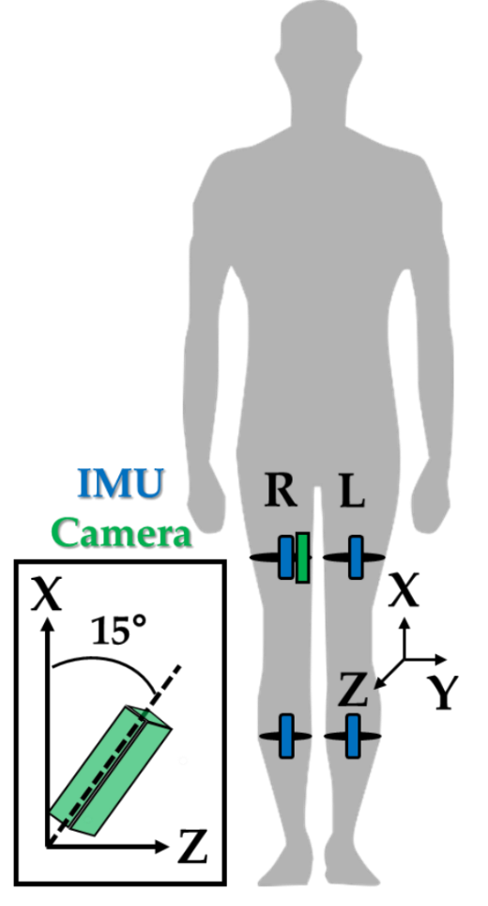
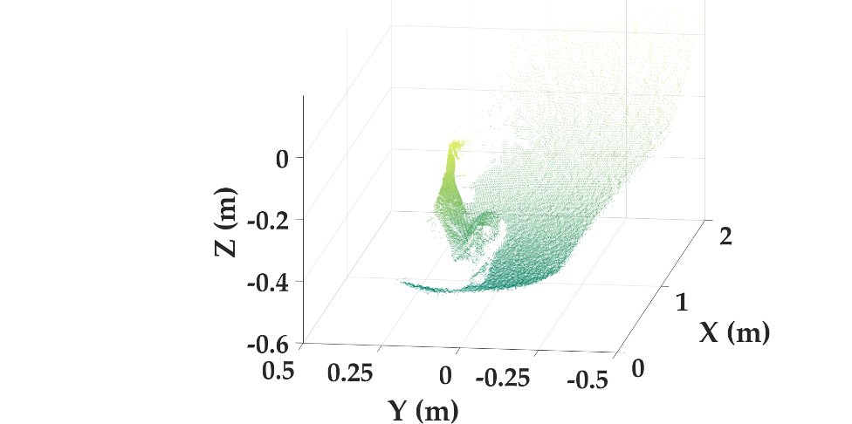
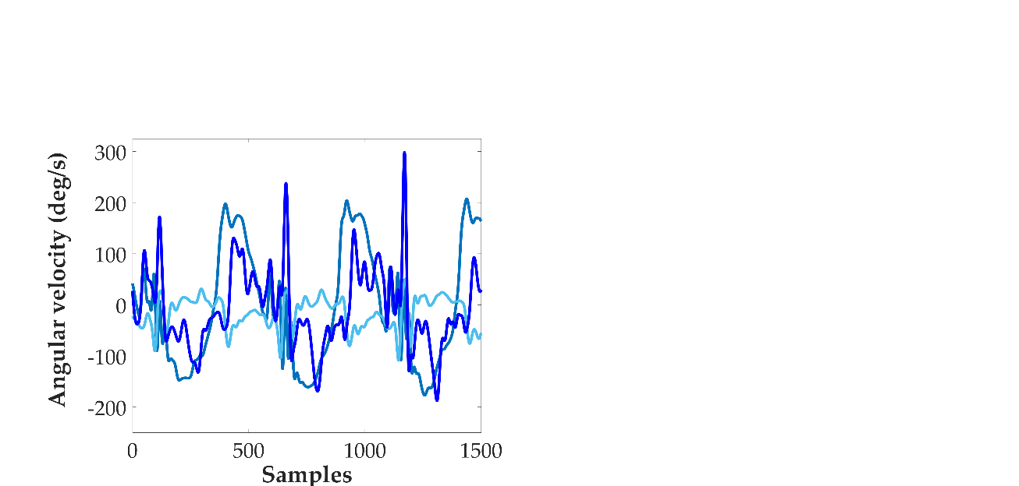
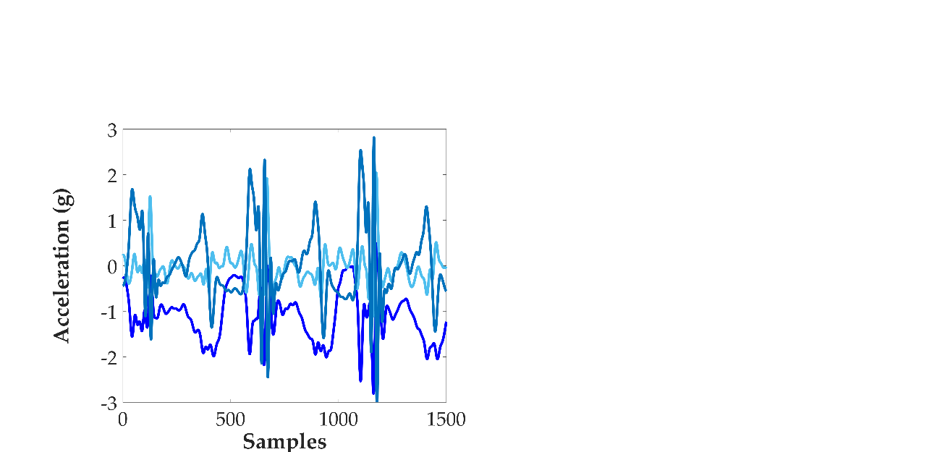
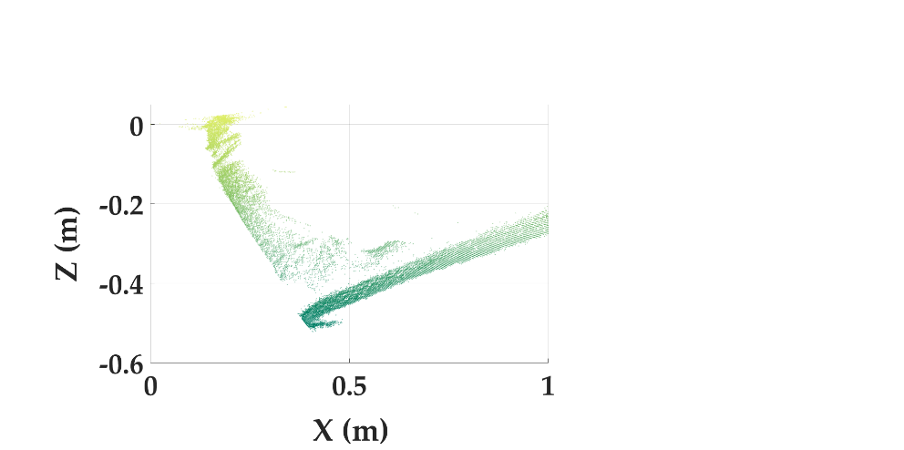
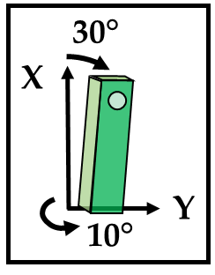
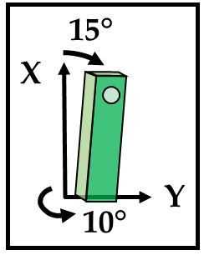
30°
X
DEPTH
IMU
Y
10°

Slide 15
Raw Data
Depth data
2D Projection
Left (Contralateral) Foot and Shank
a) Right Leg
b) Left Leg
1a) Remove Initial Rotation
1b) 2D Ground Removal
2a) RANSAC Ground Fit
Ground Angle, θ
Shank Angle, φ
2b) Morphological Filtering & CCL
3b) Shank Linear Fit

Slide 16

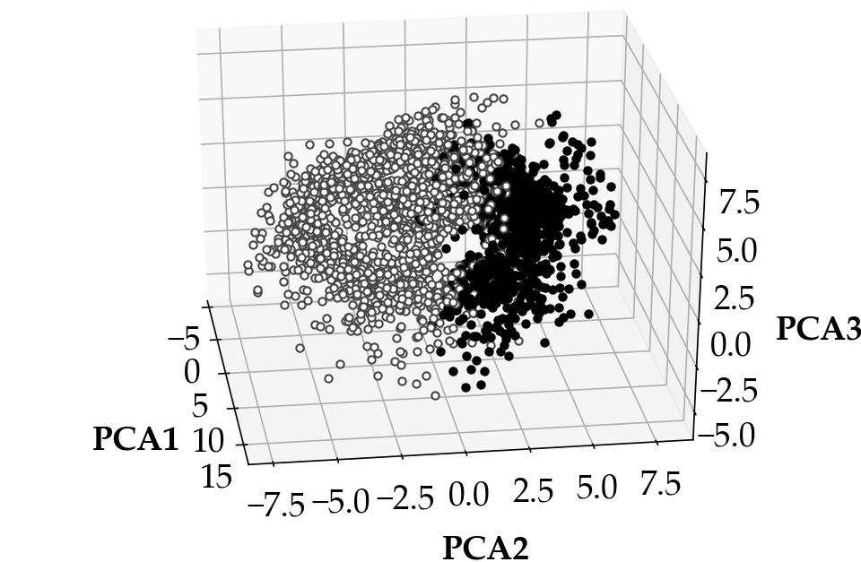
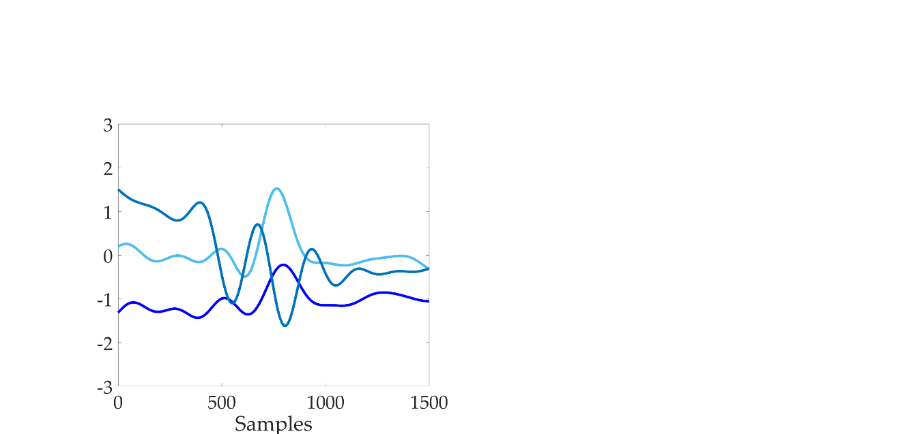
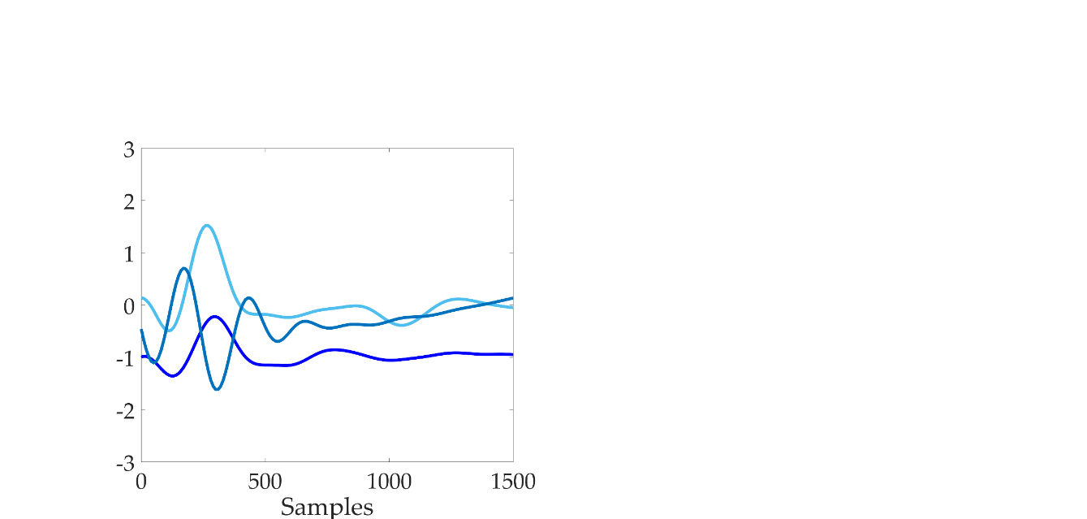
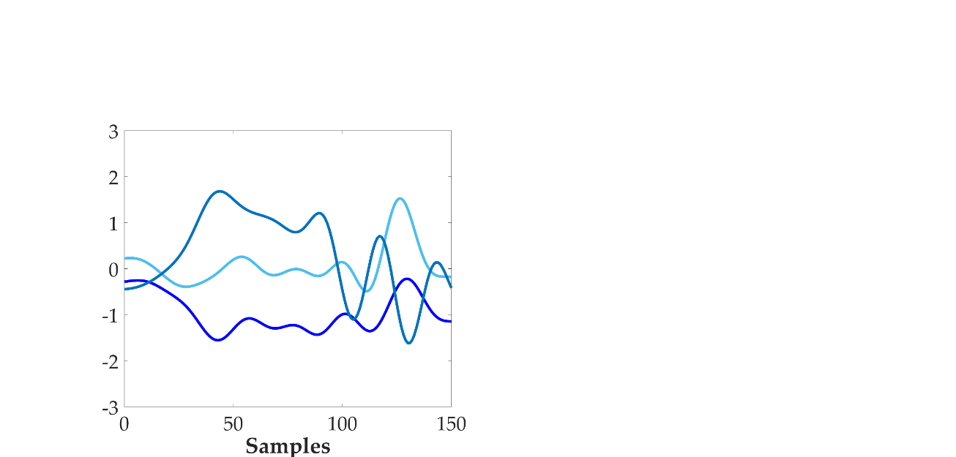
Windowing
Feature extraction
Classification
Stance
Swing

Slide 17
Windowing
Feature extraction
Classification
Stance
Swing

Slide 18
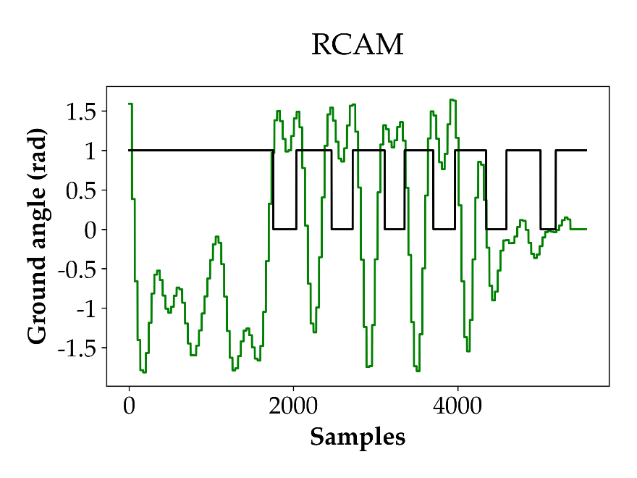
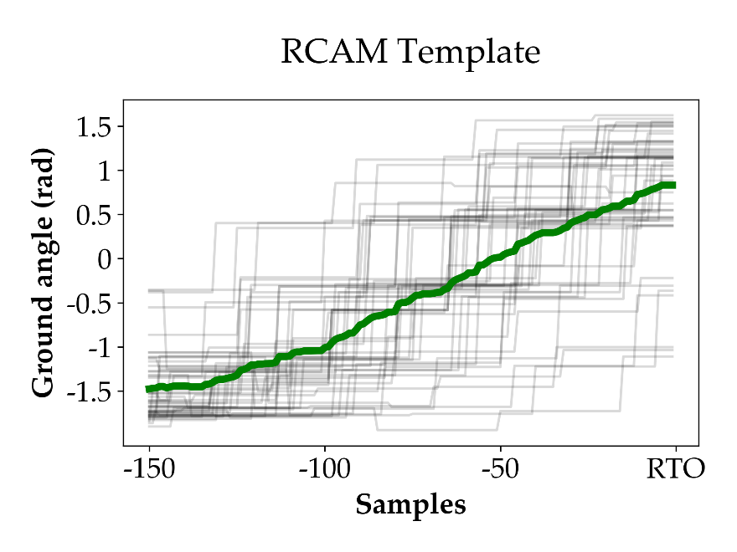
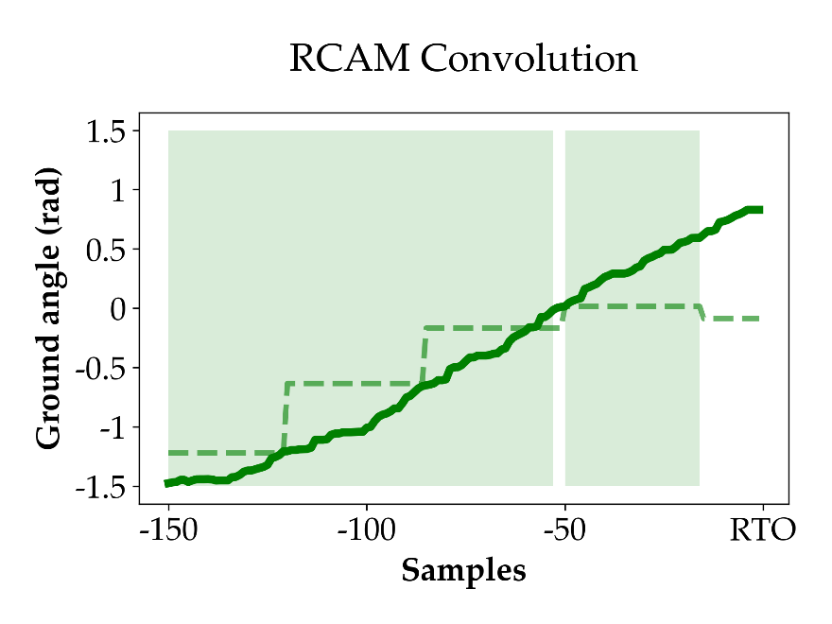
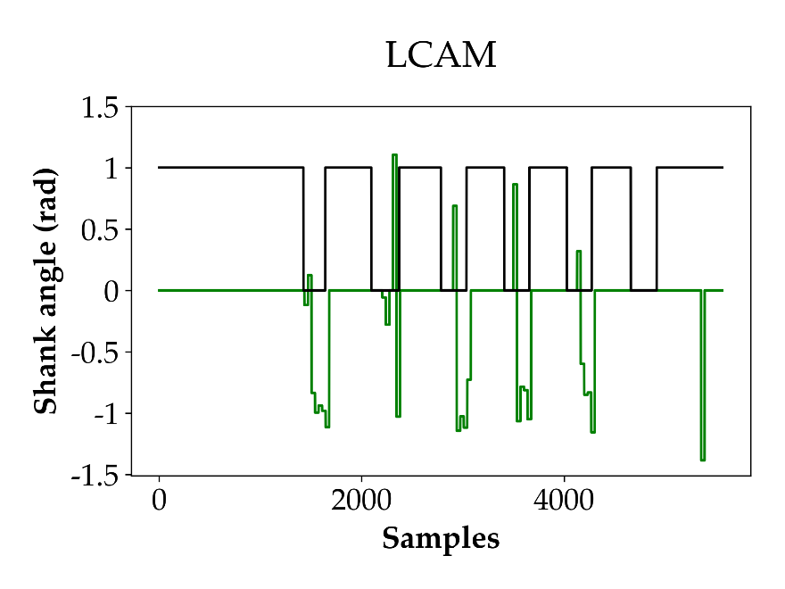
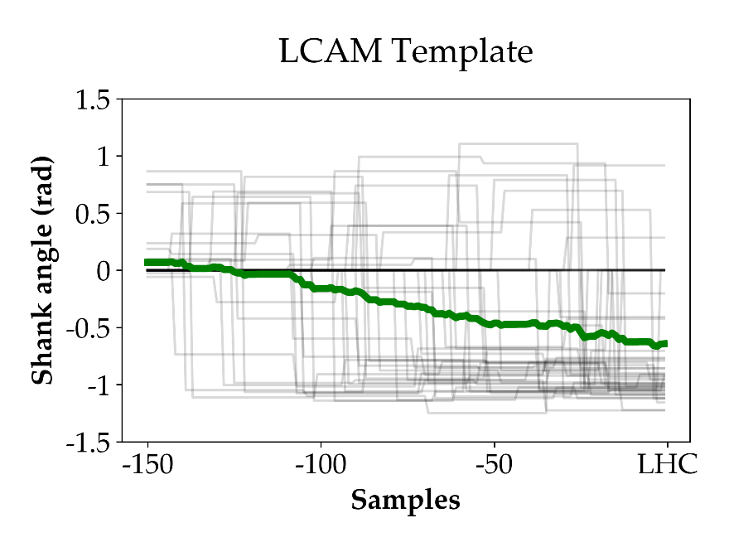
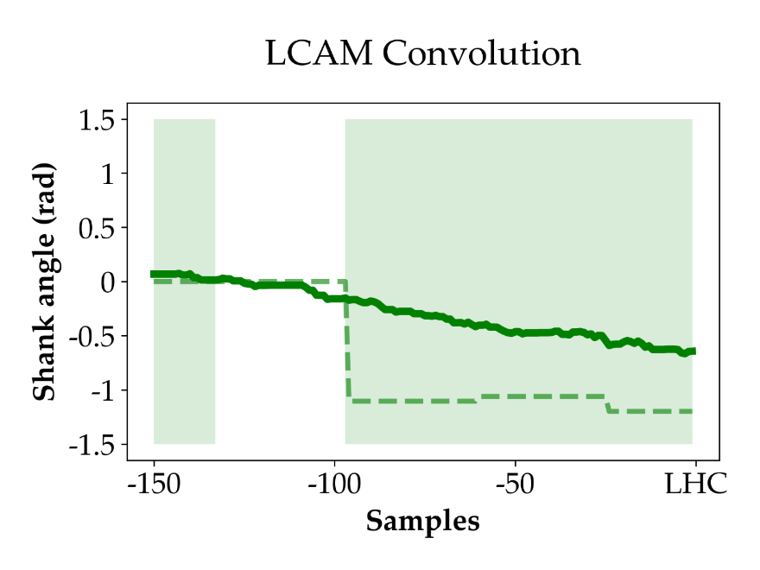

Slide 19

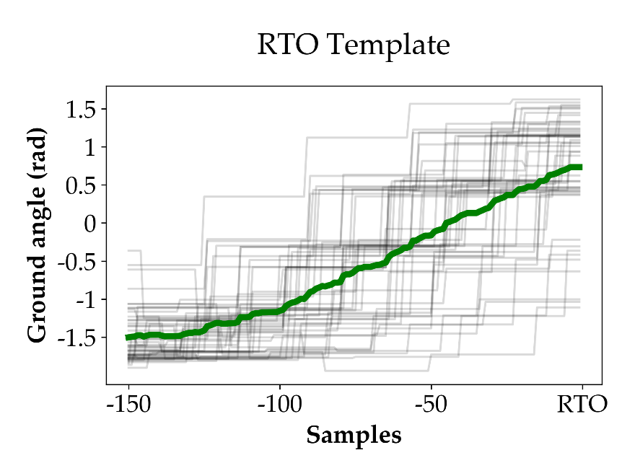
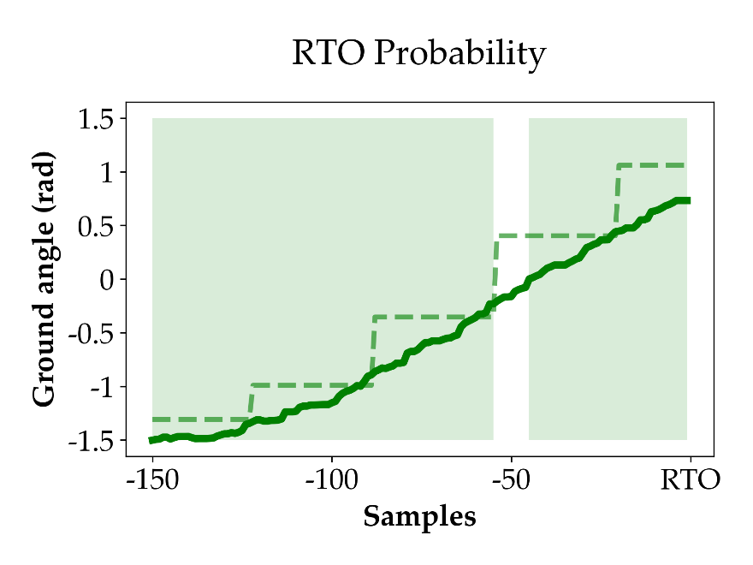

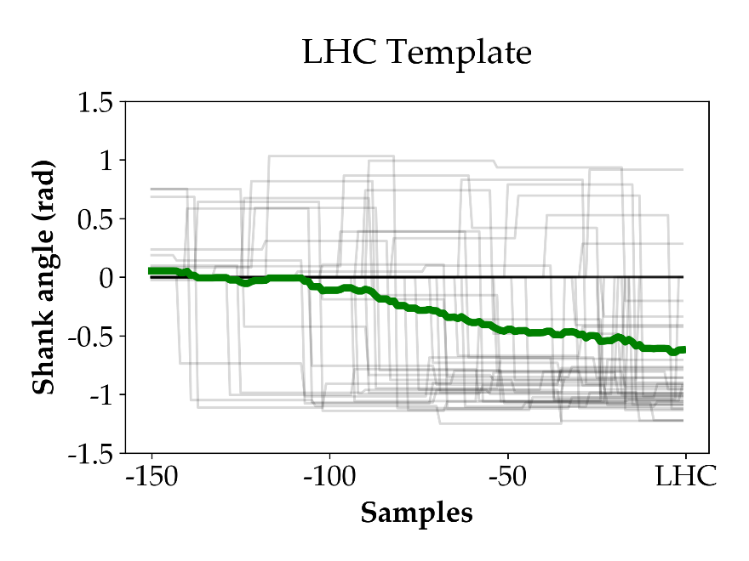
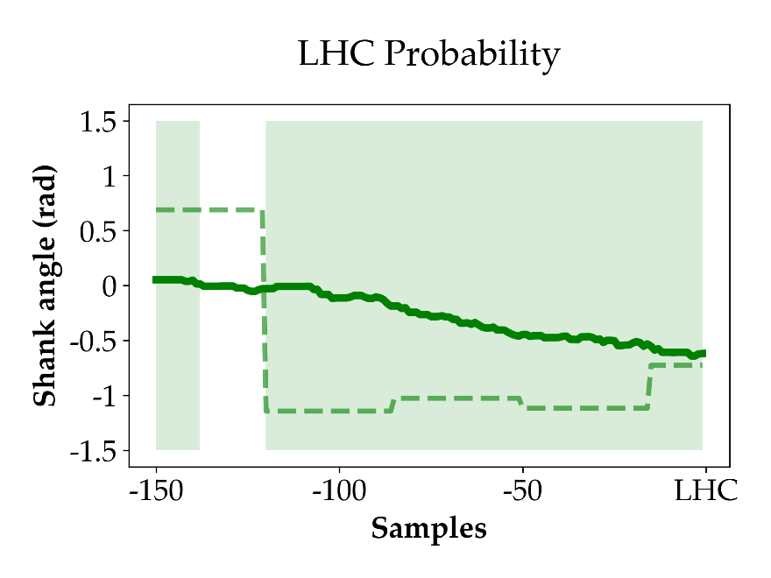
a) RTO Feature
b) RTO Template
c) RTO Probability
P(RTO) = 0.94
a) LHC Feature
b) LHC Template
c) LHC Probability
P(LHC) = 0.89

Slide 20
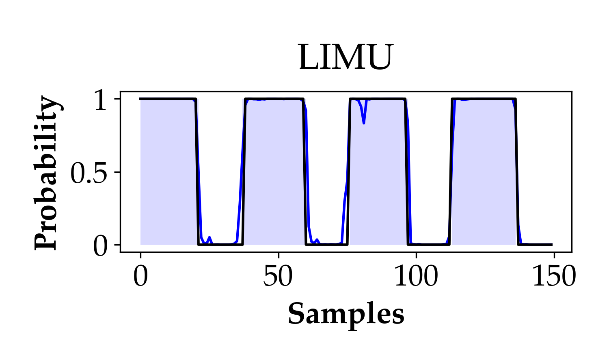
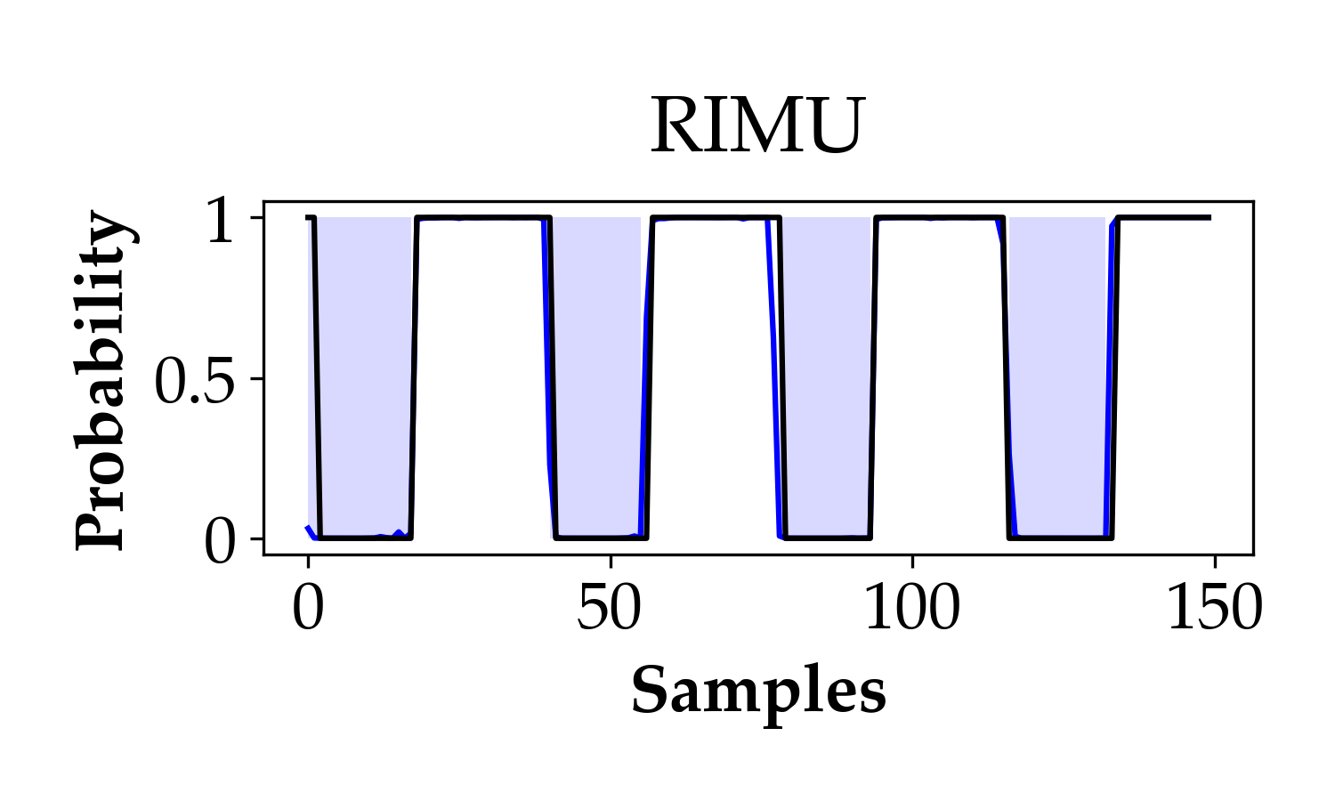
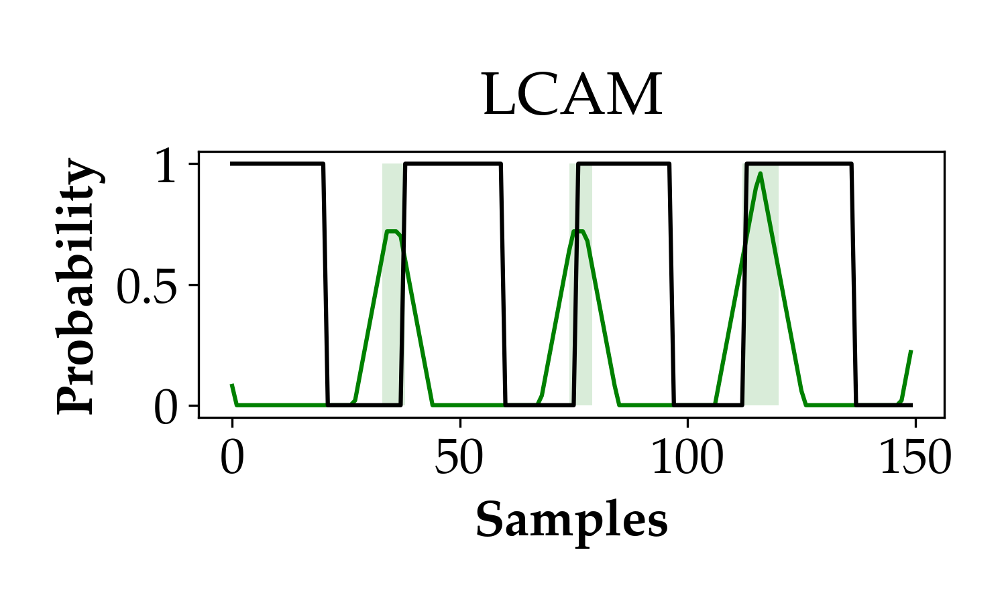
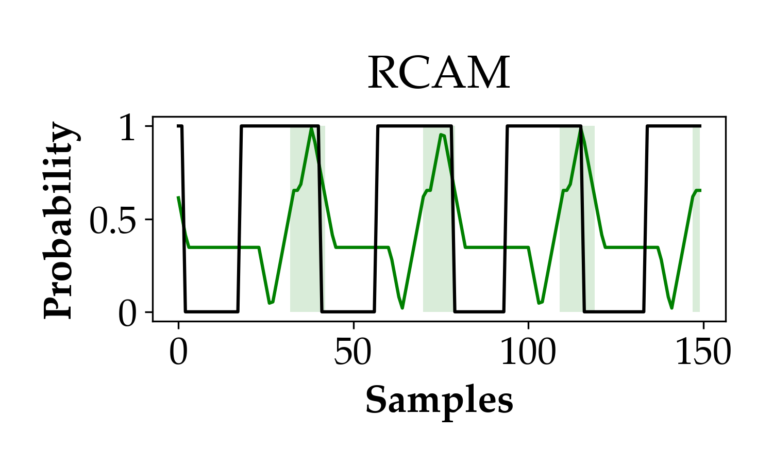
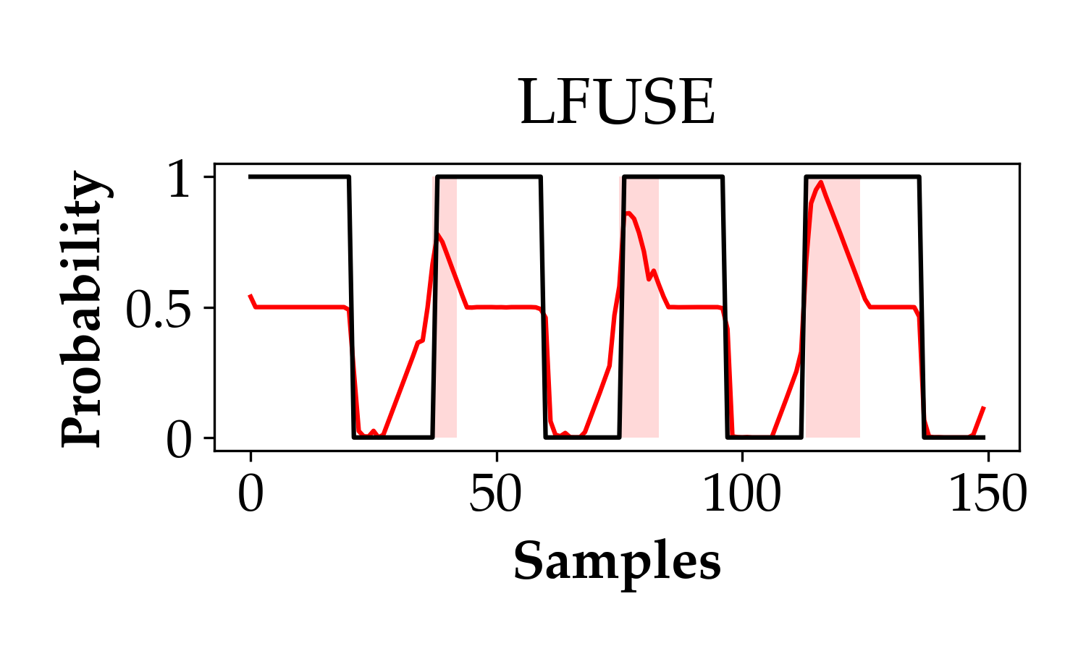
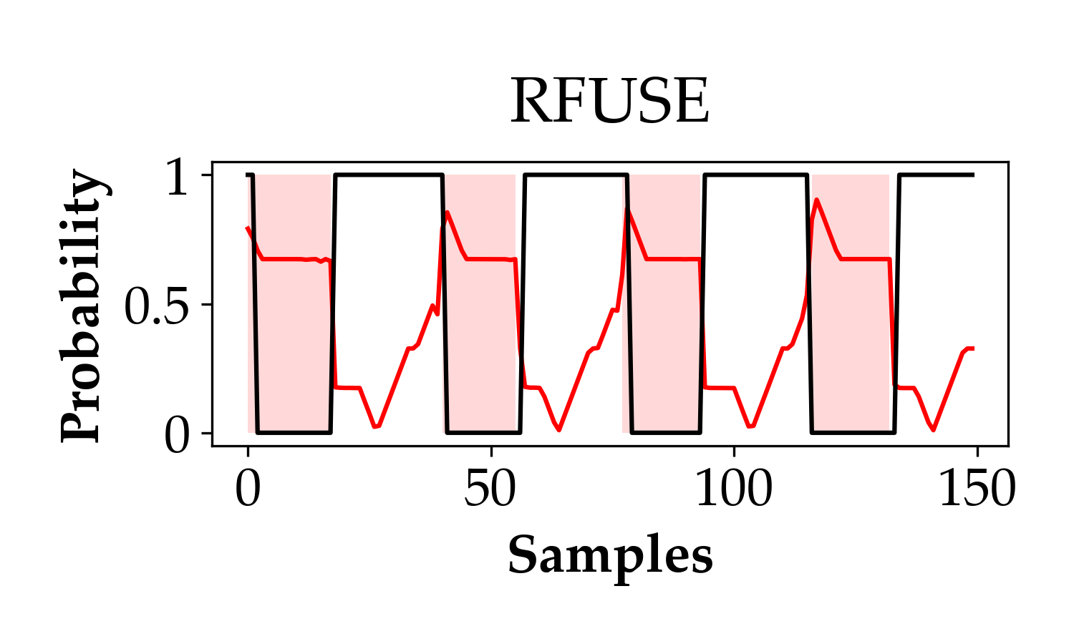

Slide 21
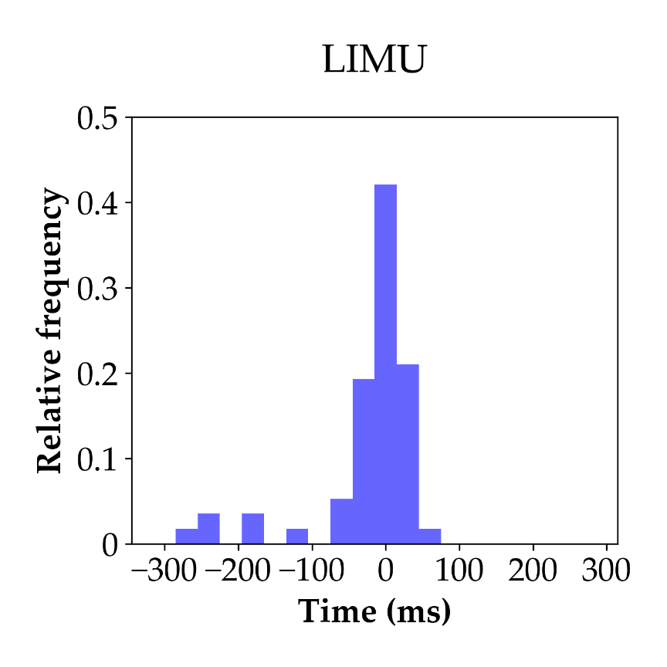
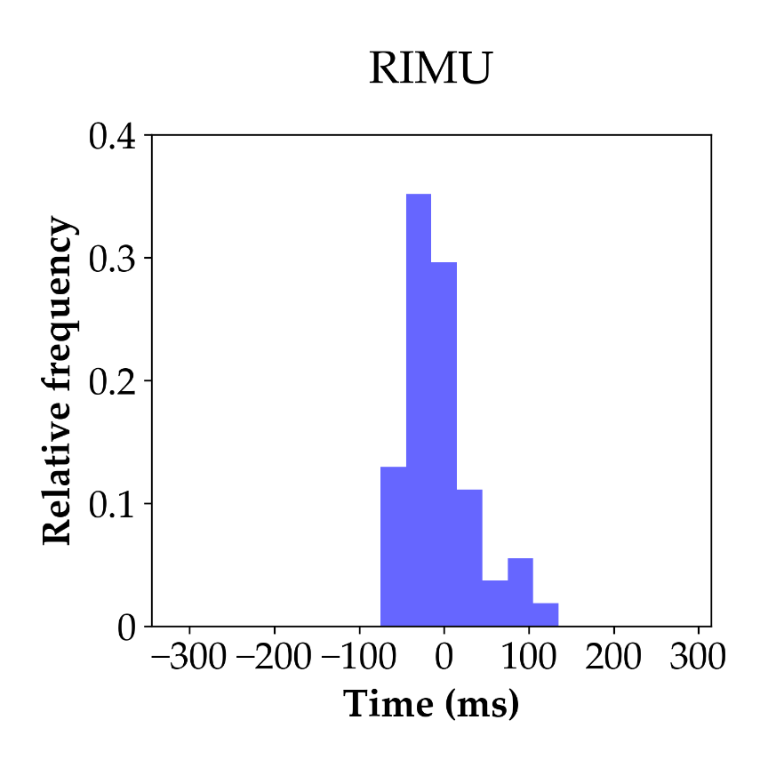
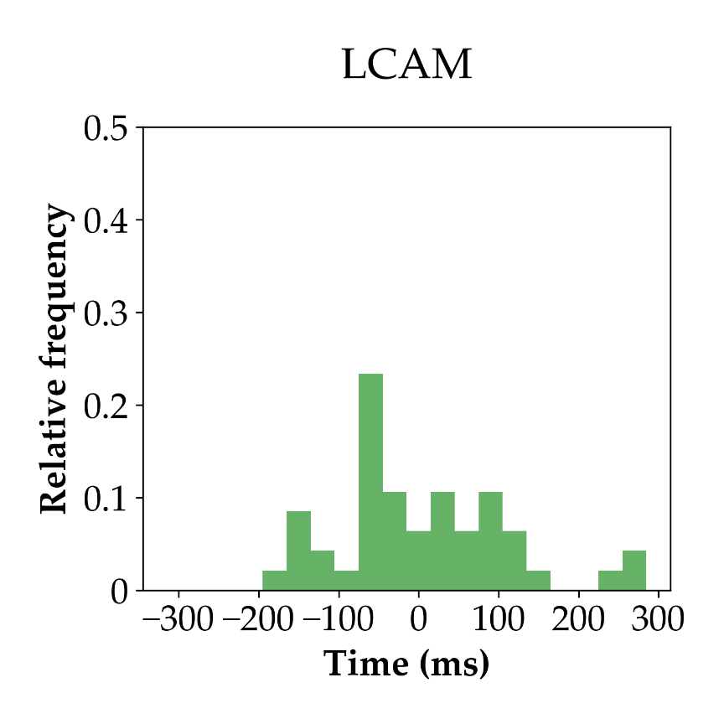
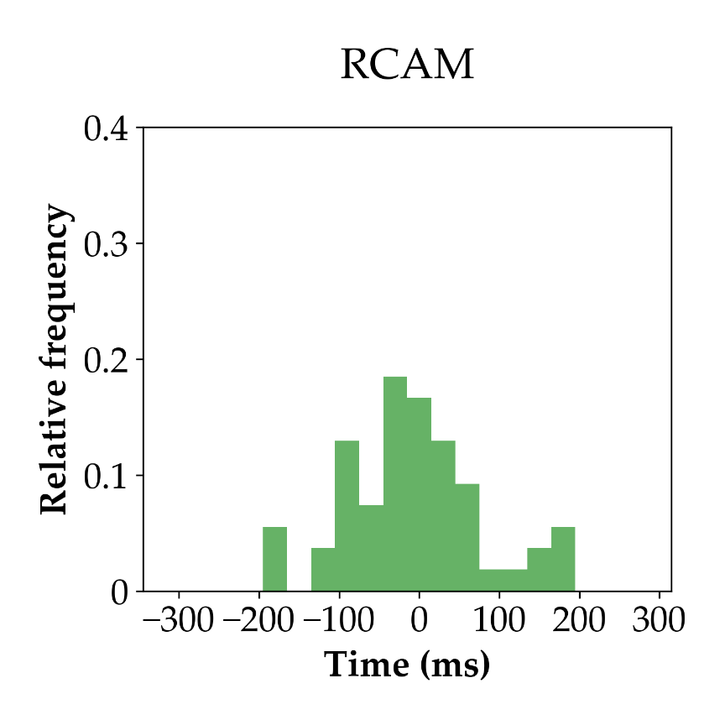
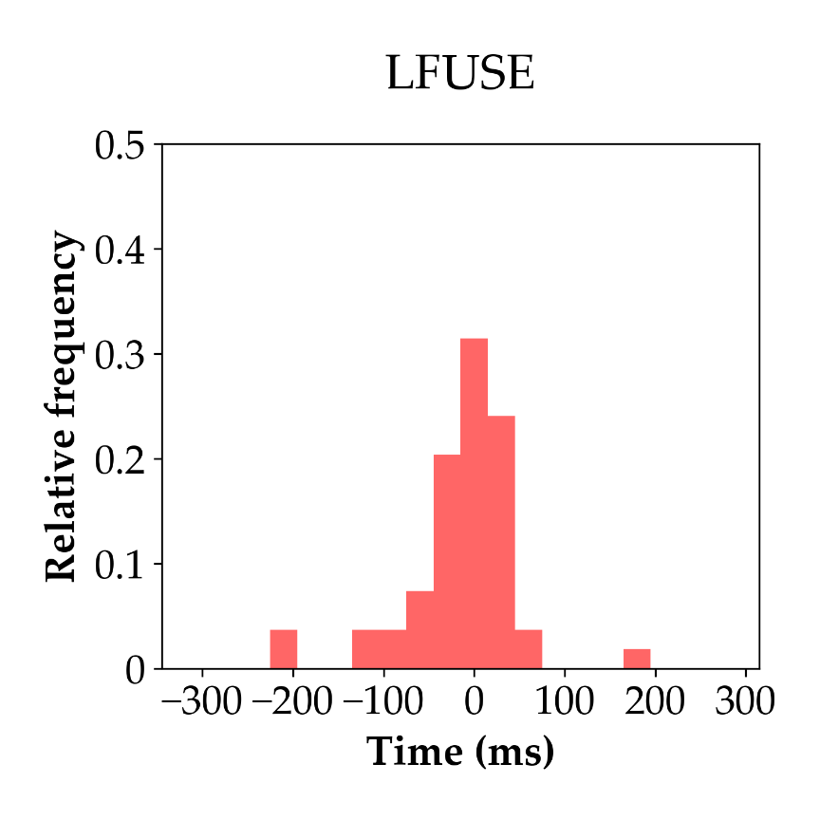
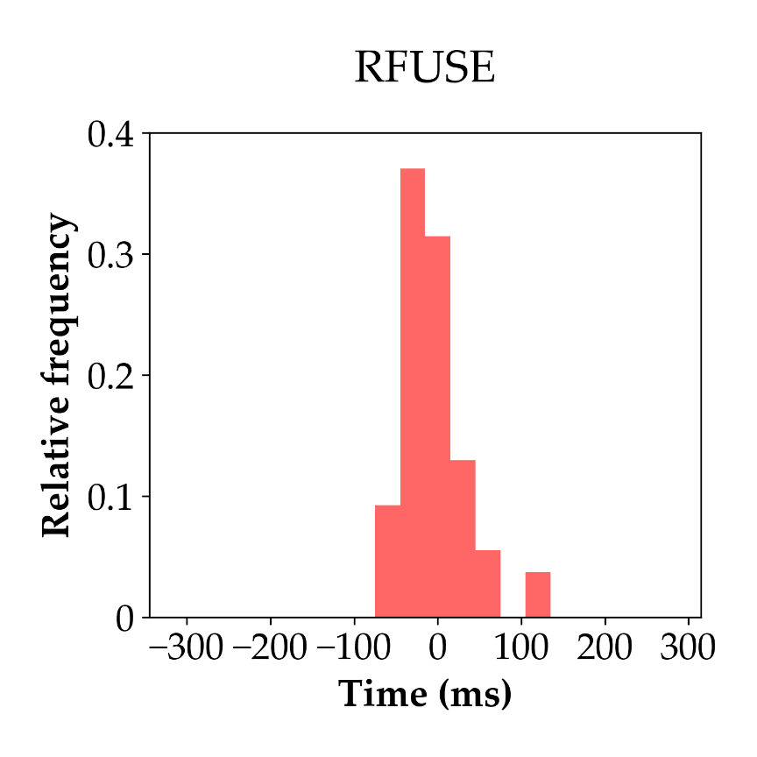

Slide 22
